Slide 1
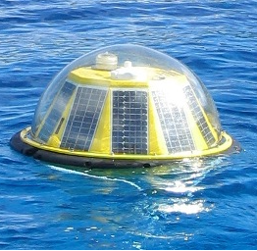
AQUABOT
An Autonomous Oxygenation Vehicle For Replacing Oxygen Lost In Lakes And Estuaries As A Result Of Eutrophication

Slide 2
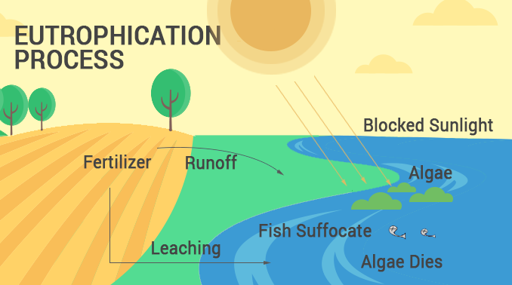
What is Eutrophication?
It’s a problem that should matter to you, whether you live near lakes or oceans or not. That’s because it begins wherever people live; and ends with collateral impairment to resources, we all use and enjoy. It all starts when nutrients get into lakes and oceans. Remember, what’s waste to humans can be food to plants and other creatures. Nutrients feed blue green algae, like they do other plants. Blue green algae grows and blocks sunlight. Plants die without sunlight. Eventually, the blue green algae dies too. Aerobic bacteria digest the dead plants, using up remaining oxygen, and giving off carbon dioxide. If they can’t swim away, fish and other wildlife become unhealthy, or die without oxygen.

Slide 3
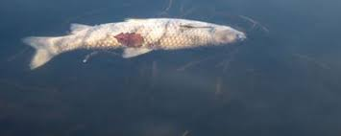
Lakes Are Losing Oxygen
Declines in dissolved oxygen in freshwater are 2.75 to 9.3 times greater than observed in the world’s oceans and are threatening essential lake ecosystem dynamics.
Climate change is also contributing to falling oxygen levels in lakes across the world.

Slide 4
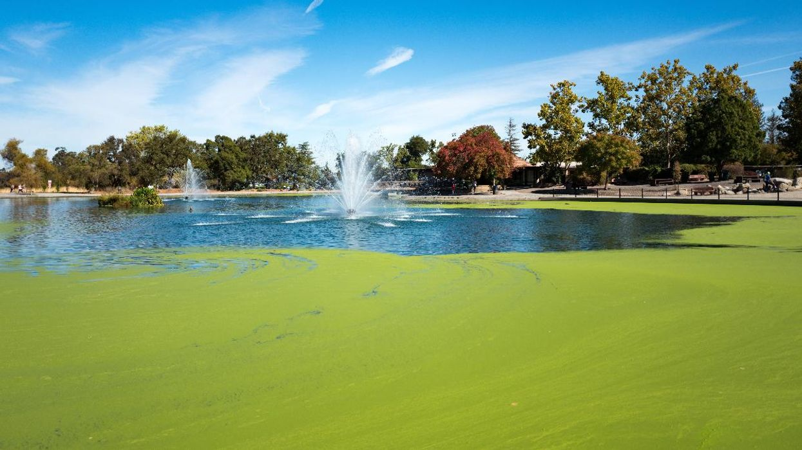
Algae Blooms Could Spew Lethal Toxins Into the Air
Algae blooms have already been shown to kill the fish that swim in the water they infest or the animals that drink from it. Now, new research indicates they could even poison the air.
Scientists for the first time detected an airborne instance of the algal toxin anatoxin-a (ATX), also known as "very fast death factor."
An algal bloom on a pond in Heather Farm Park,
Walnut Creek, California

Slide 5
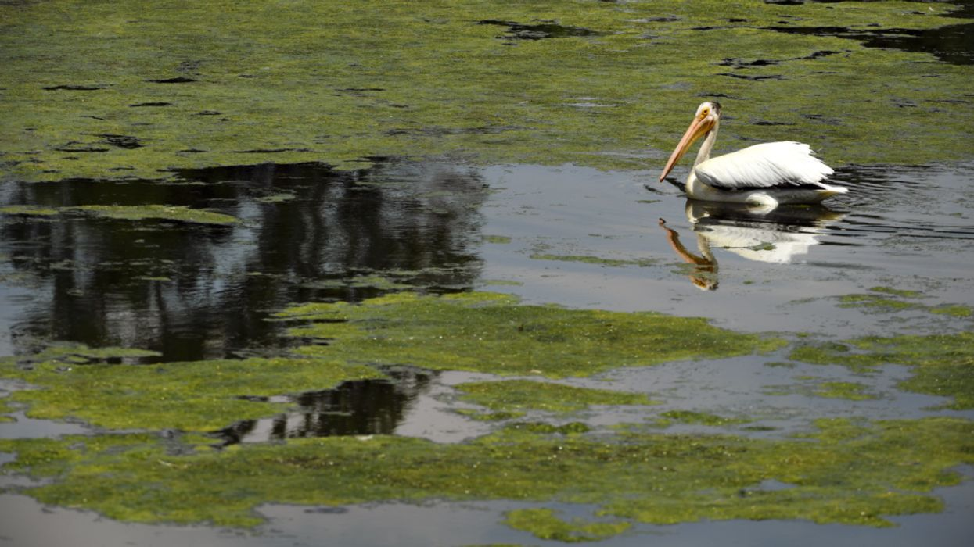
What's Lurking in Your Lake?
Assessment's show, governments and state agencies are already under-resourced to address harmful algae blooms.

Slide 6
Oxygen (O2) is the most fundamental parameter of lakes water itself .
It regulates biological and chemical processes, and O2 turnover is closely linked to the aquatic carbon cycle.
Currents model base lake internal metabolism
and carbon balances on lake internal oxygen dynamics.
Oxygen dynamics in lakes are driven by lake internal processes and gas exchange with the atmosphere;……
until this balance is impeded by human activity.

Slide 7
The Aquabot Advantage
Aquabot embodies sustainable green technology that infuses high levels of dissolved oxygen into stagnant waters of the lakes, ponds, etc., at a molecular level and it is chemical free.
Aquabot, simultaneously removes nitrogen and other dissolved gases into the atmosphere.
Revives the good bacteria, that consume and removes toxins from the aquatic environment.
As a result, eliminates the blue green algae blooms, and the anoxic conditions that destruct the marine habitats worldwide.

Slide 8
Proprietary Aquabot Technology
Existing or proposed lake rehabilitation configurations are designed to generate bubbles of air or oxygen from shore mounted compressors.
Inevitably the “oxygenated” bubbles will rise to the surface and be lost into the atmosphere. Such systems are less than 15% efficient.
The Aquabot infuser method does not make bubbles; instead, it infuses oxygen into the water via a company proprietary molecular exchange process.
Typical infusion rates of 90% to 95% dissolved oxygen are generated providing oxygen saturation levels > 100%.

Slide 9
Choices
Attempts to re vitalize lakes are initiated by finger pointing.
Who is responsible for this Eutrophication?
Inevitably governments shrug off the issue to consultants to study the problem.
The missing link in the process is procuring and mobilizing the equipment or technology to remediate the problem.
An internet search will reveal a dismal array of proposed solutions proffered; most, a result of funded “scientific” studies.
Your choices are pass the buck…or be proactive and deploy an Aquabot and begin recovering your lakes health and avoid property de- valuation.
AQUABOT at Work

Slide 10
Still Not Convinced?
\
This could happen next in your neighborhood.
The City of Victoria, British Columbia, Canada, after exhaustive studies, the CRD (Capital Regional District) will deploy, (2022) massive air compressors, pipes and diffusers to “remediate” Elk Lake, a public playground area.
.
“The proposed system would deliver 1,150 kilograms of oxygen per day into the bottom level of Elk Lake, CRD says. The in-lake systems are expected to have a capital cost of $1.4 million, with ongoing operational costs of $100,000 to $150,000 per year.”
Your tax dollars at work?
Alternatively, deploy Quantity 8 Aquabots around the Lake for ½ the capital cost…..
and enjoy zero operational fees.
Elk Lake’s unpleasant water expected to improve next year with oxygen system.
Times Colonist APRIL 11, 2021

Slide 11
RESOLVING EUTROPHICATION
AQUABOT
Consulting Engineers
Operating Costs……. NIL
Capital Costs Ostensibly 1/2 of a custom engineered installation
Efficiency of Oxygenation >90%
Studies Required? Request template guidelines from us.
24/7 Lake health public reports via cel phone Ap
5 Year Aquabot warrantee
Operating Costs 24/7….TBA
Capital Costs ..depends on studies
Efficiency of Oxygenation <30%
Studies Required. Definitely
Lake Health reports. Property of Engineers
Equipment failure to the account of the Public purse.

Slide 12
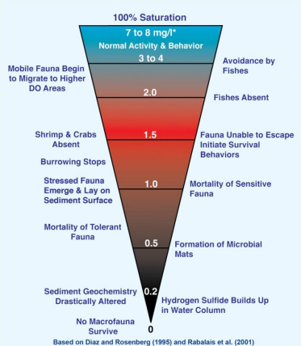
SCIENTIFIC RESEARCH FOR MARINE FAUNA

